Slide 1


Internal Demo Day: Data Circle
Fall 2025
DCP Hamburg
We use tech to connect human potential and opportunity with dignity & humility
We use tech to connect human potential and opportunity with dignity & humility

Slide 2
By ALPHA GROUP Assimagbe Albert Raphael & Saad Ali 📊 Based on CDC H1N1 2009 Survey Data
Flu Vaccination Predictor Project

Slide 3
Introduction
Seasonal and pandemic flu vaccines are vital public health tools. Despite availability, uptake varies due to beliefs, demographics, and access. This study uses machine learning to understand and predict who gets vaccinated
Objectives:
Modeling Approach
Analyse public attitudes and behaviours toward vaccination
Predict uptake of:
H1N1 vaccine
Seasonal flu vaccine
Interpret model outputs to find key influencing factors
Offer data-driven recommendations for public health strategy
Random Forest Classifier:
Captures nonlinear patterns
Suitable for feature importance
Decision Tress:
Suitable for feature importance
Logistic Regression:
Interpretable linear model
Good for policy recommendations
Separate models trained for H1N1 and Seasonal vaccine prediction

Slide 4

Dataset Overview
Source: CDC 2009 H1N1 Flu Survey
Size: 26,707 respondents across U.S, 36 features
Features:
Demographics (age, race, education)
Health behavior (doctor visits, chronic conditions)
Opinion (concern about flu, confidence in vaccines)
Two binary target variables:
H1N1 Vaccine (Yes/No)
Seasonal Vaccine (Yes/No)

Slide 5
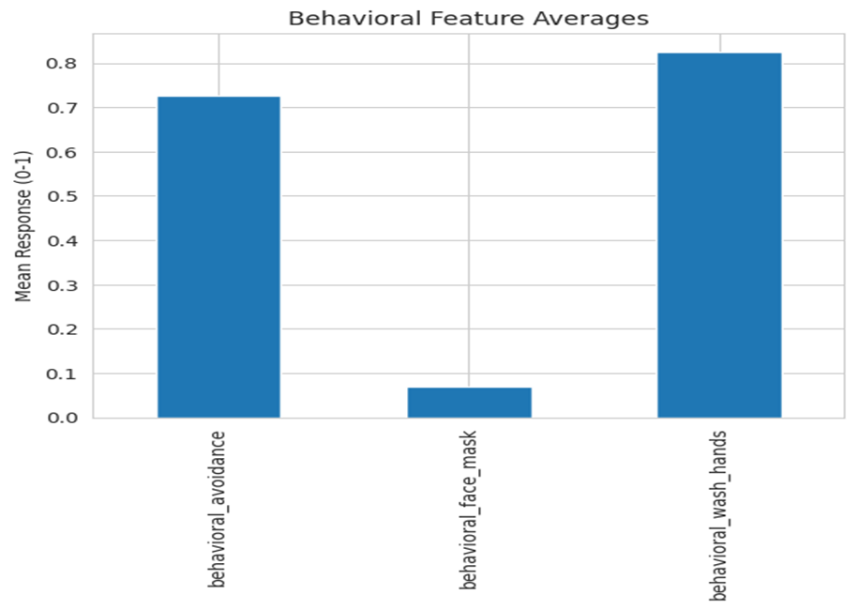
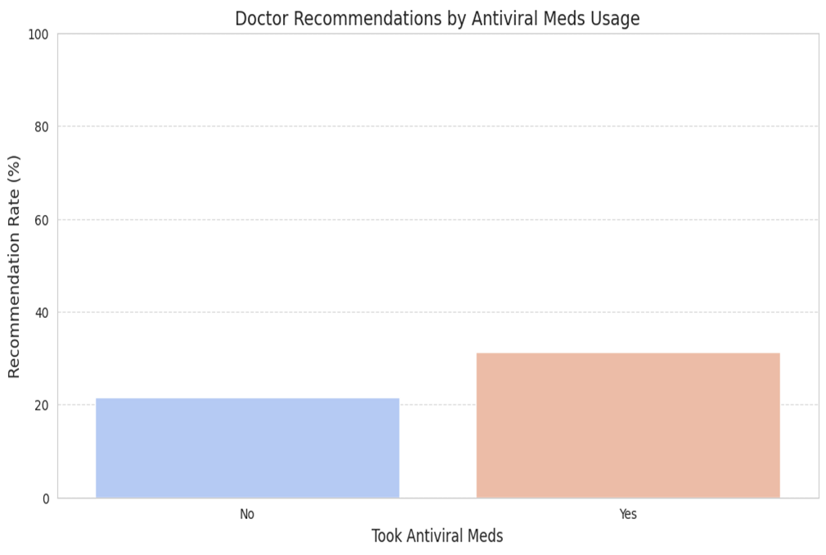
Exploratory Data Analysis (EDA)
Concern about H1N1 Virus = more handwashing
Doctor Recommendations Influence Vaccination
922.091
804.469

Slide 6
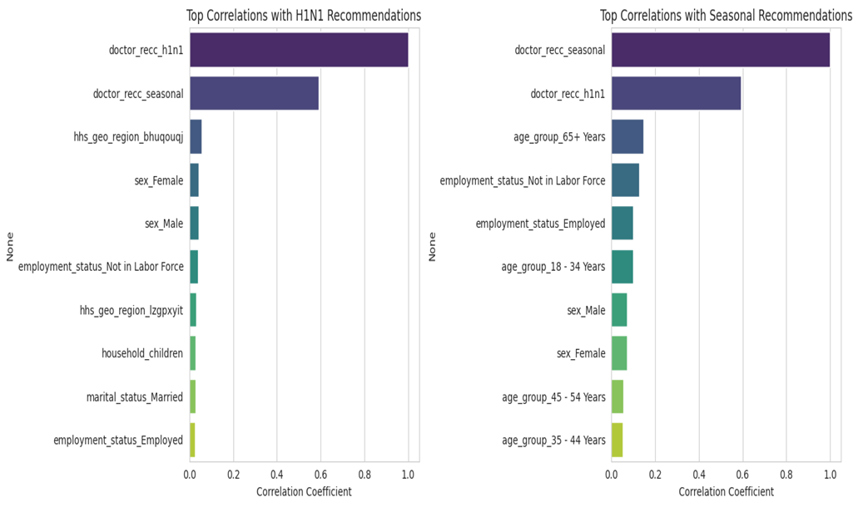
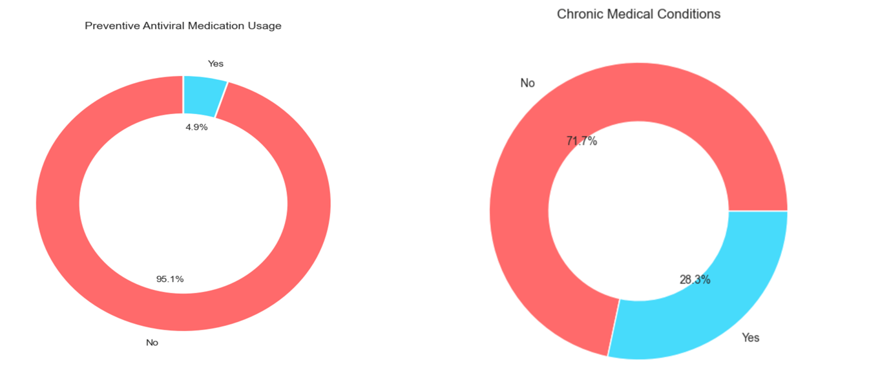
Exploratory Data Analysis (EDA)
Older adults (65+) more likely to get seasonal flu shots
4.9% Persons takes Preventive Antiviral Medication while, 28.3% Persons has chronic medical conditions
922.091
804.469

Slide 7
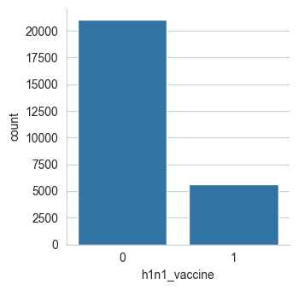
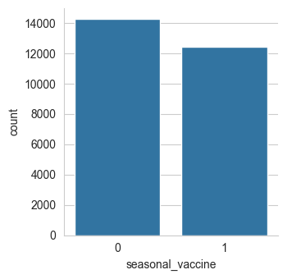
Target Variable Distribution
H1N1 Vaccine: Majority did not take it
Seasonal Vaccine: Higher uptake

Slide 8
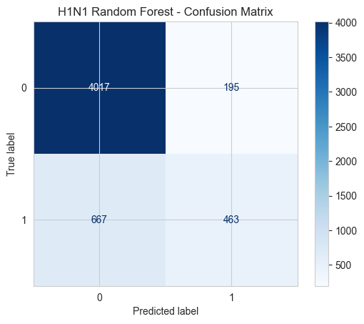
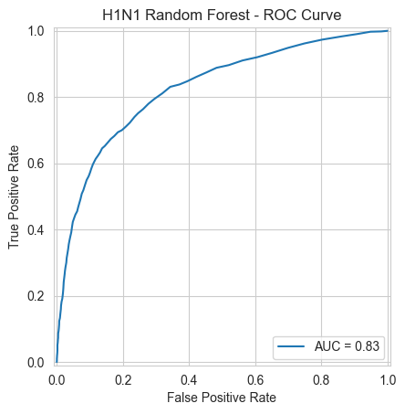
H1N1 Vaccine– Random Forest Performance
Accuracy (0.84): The model correctly predicts 84% of cases.
ROC AUC (0.83): Good ability to distinguish between vaccinated and unvaccinated individuals.
F1 Score (0.52): Moderate balance between precision and recall — suggests the model struggles more with imbalanced classes or identifying positives accurately.
Interpretation: While overall accuracy and AUC are good, the low F1 score suggests the model may be missing many vaccinated individuals (low recall or precision).

Slide 9
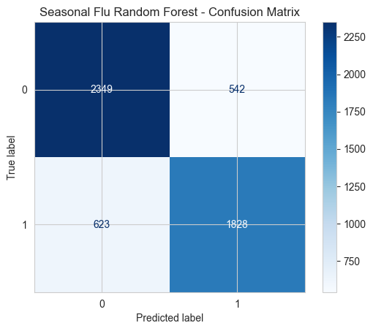
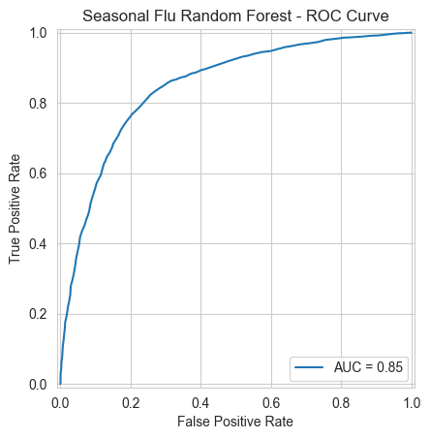
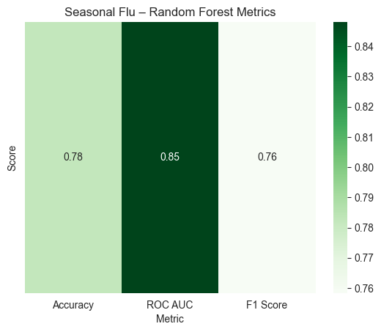
Seasonal Flu Vaccine – Random Forest Performance
Accuracy (0.78): Slightly lower overall correctness than H1N1.
ROC AUC (0.85): Strong ability to rank predictions.
F1 Score (0.76): High — indicates good balance between precision and recall.
Interpretation: The seasonal flu model performs better in terms of F1 score, meaning it's more effective at identifying vaccinated individuals reliably, despite a slightly lower accuracy.

Slide 10
Partial Dependence Plots (H1N1 Vaccine)
Key Findings:
Beliefs and Opinions Matter Most:
↑ Belief in vaccine effectiveness → ↑ Likelihood of vaccination
↑ Flu risk perception → ↑ Likelihood of vaccination
↓ Fear of vaccine side effects → ↑ Vaccination probability
Doctor's Recommendation:
When a doctor recommends the seasonal flu shot, people are significantly more likely to take the H1N1 vaccine.
Age Factor:
Older age groups show higher vaccination likelihood
Education and Concern:
Higher education and concern about H1N1 modestly increase uptake.
Minimal Influence from:
Demographic features like region, number of adults in household, and respondent ID.
Lines for these are mostly flat, showing weak effect.
922.091
804.469

Slide 11
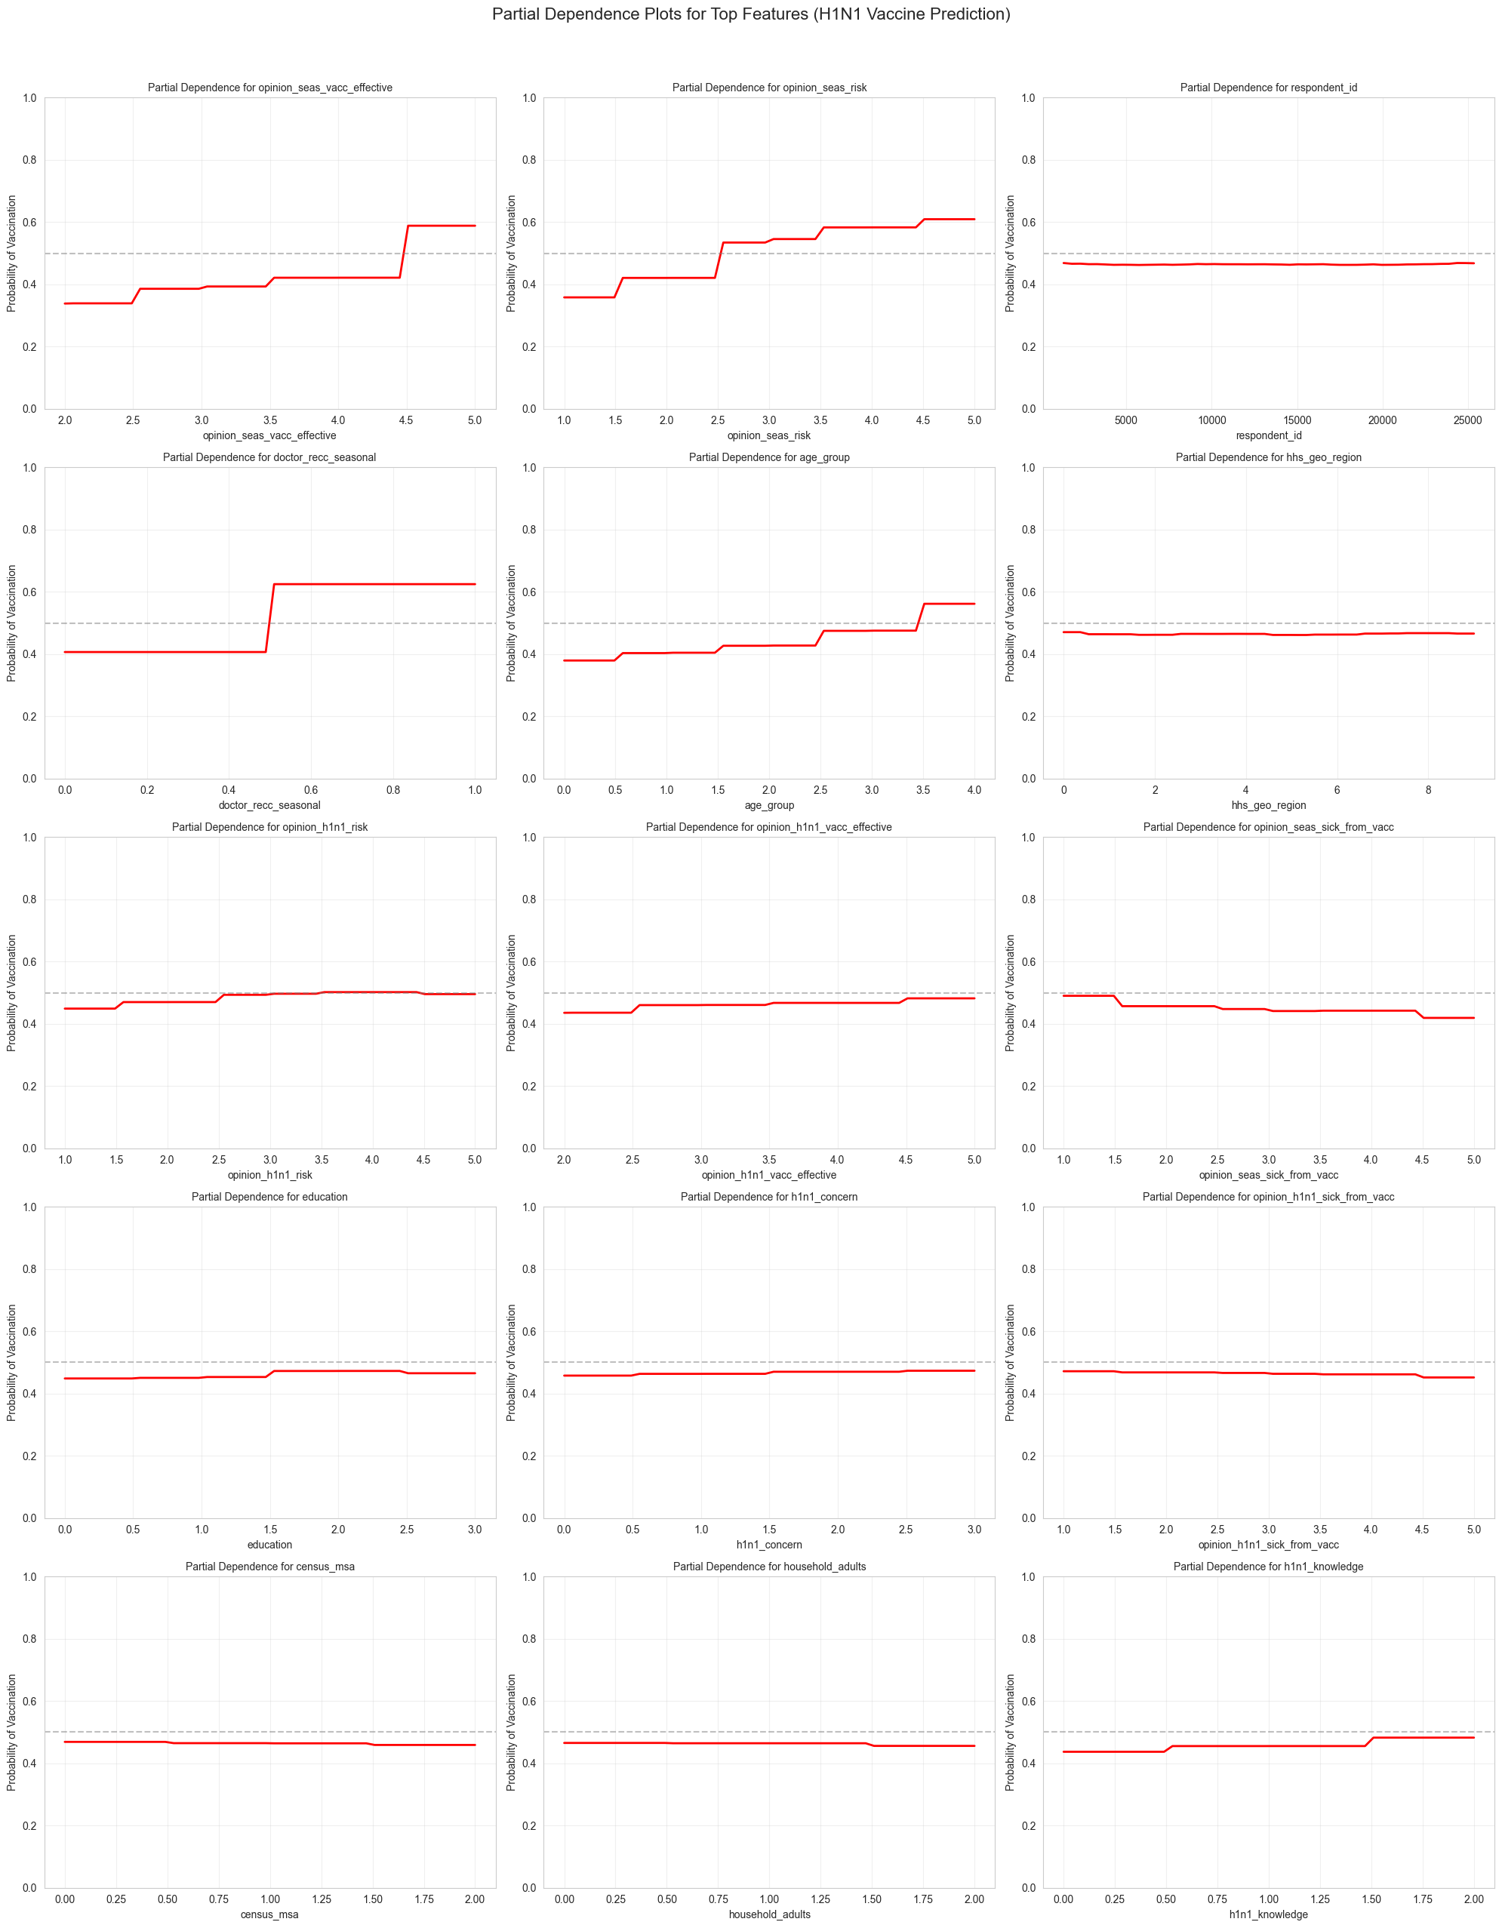
922.091
804.469

Slide 12
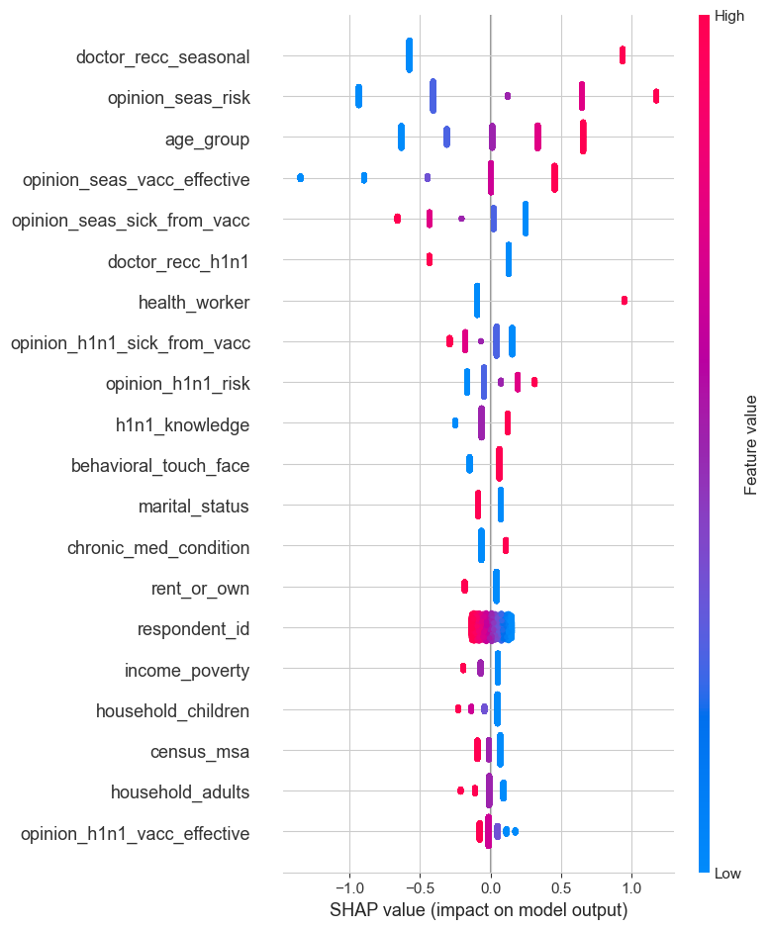
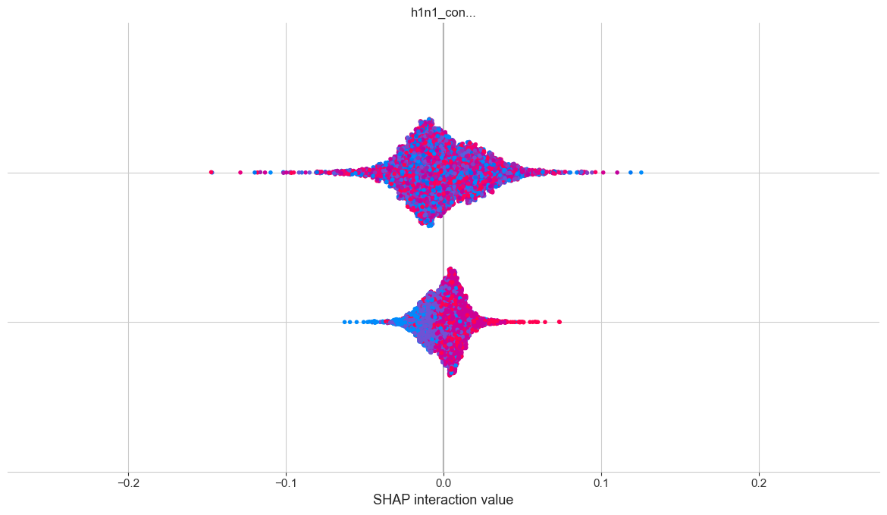
SHAP – Model Interpretability
SHAP Summary Plot - SEASONAL Vaccine (Logistic Regression)
SHAP Summary Plot - H1N1 Vaccine (Random Forest Classifier)

Slide 13
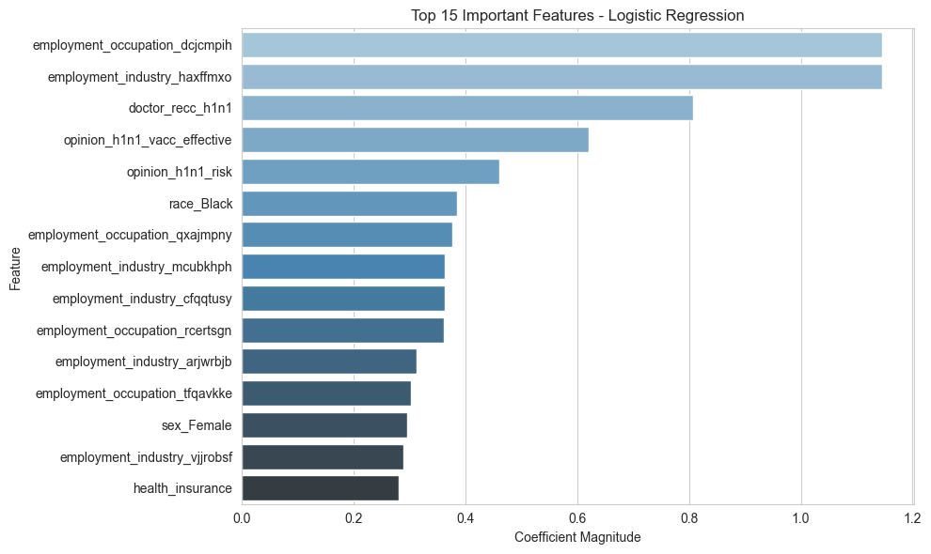
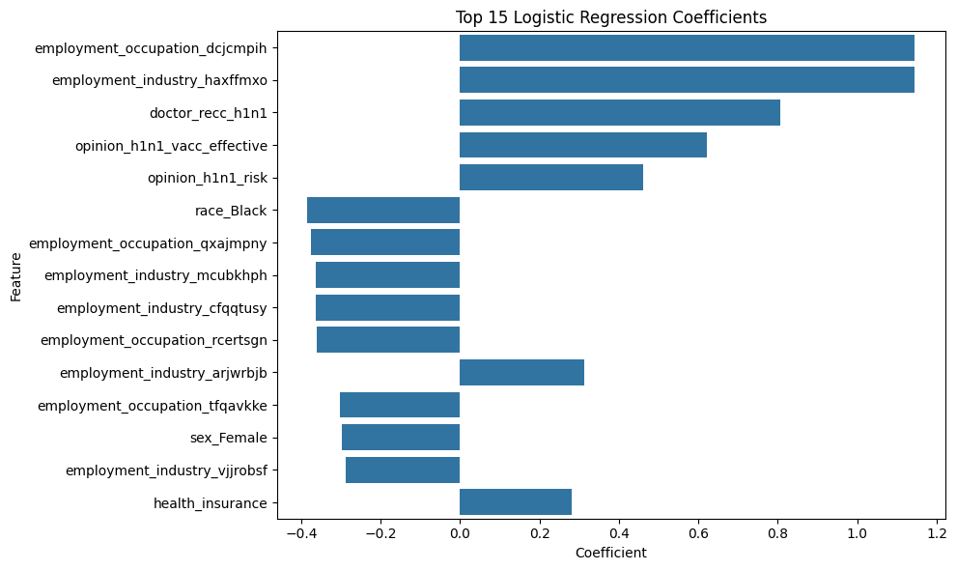
Logistic Regression – Feature Weights
This graph highlights that occupation, medical advice, and personal opinions are the strongest drivers in H1N1 vaccination behaviour. Demographic factors and insurance also play a role but are less dominant.
This bar chart displays both positive and negative influences on H1N1 vaccination based on a logistic regression model. Key predictors like occupation, industry, and doctor recommendations increase the likelihood of vaccination. Positive opinions about vaccine effectiveness and risk also encourage uptake. Conversely, certain demographics and job sectors are linked to lower vaccination rates.

Slide 14
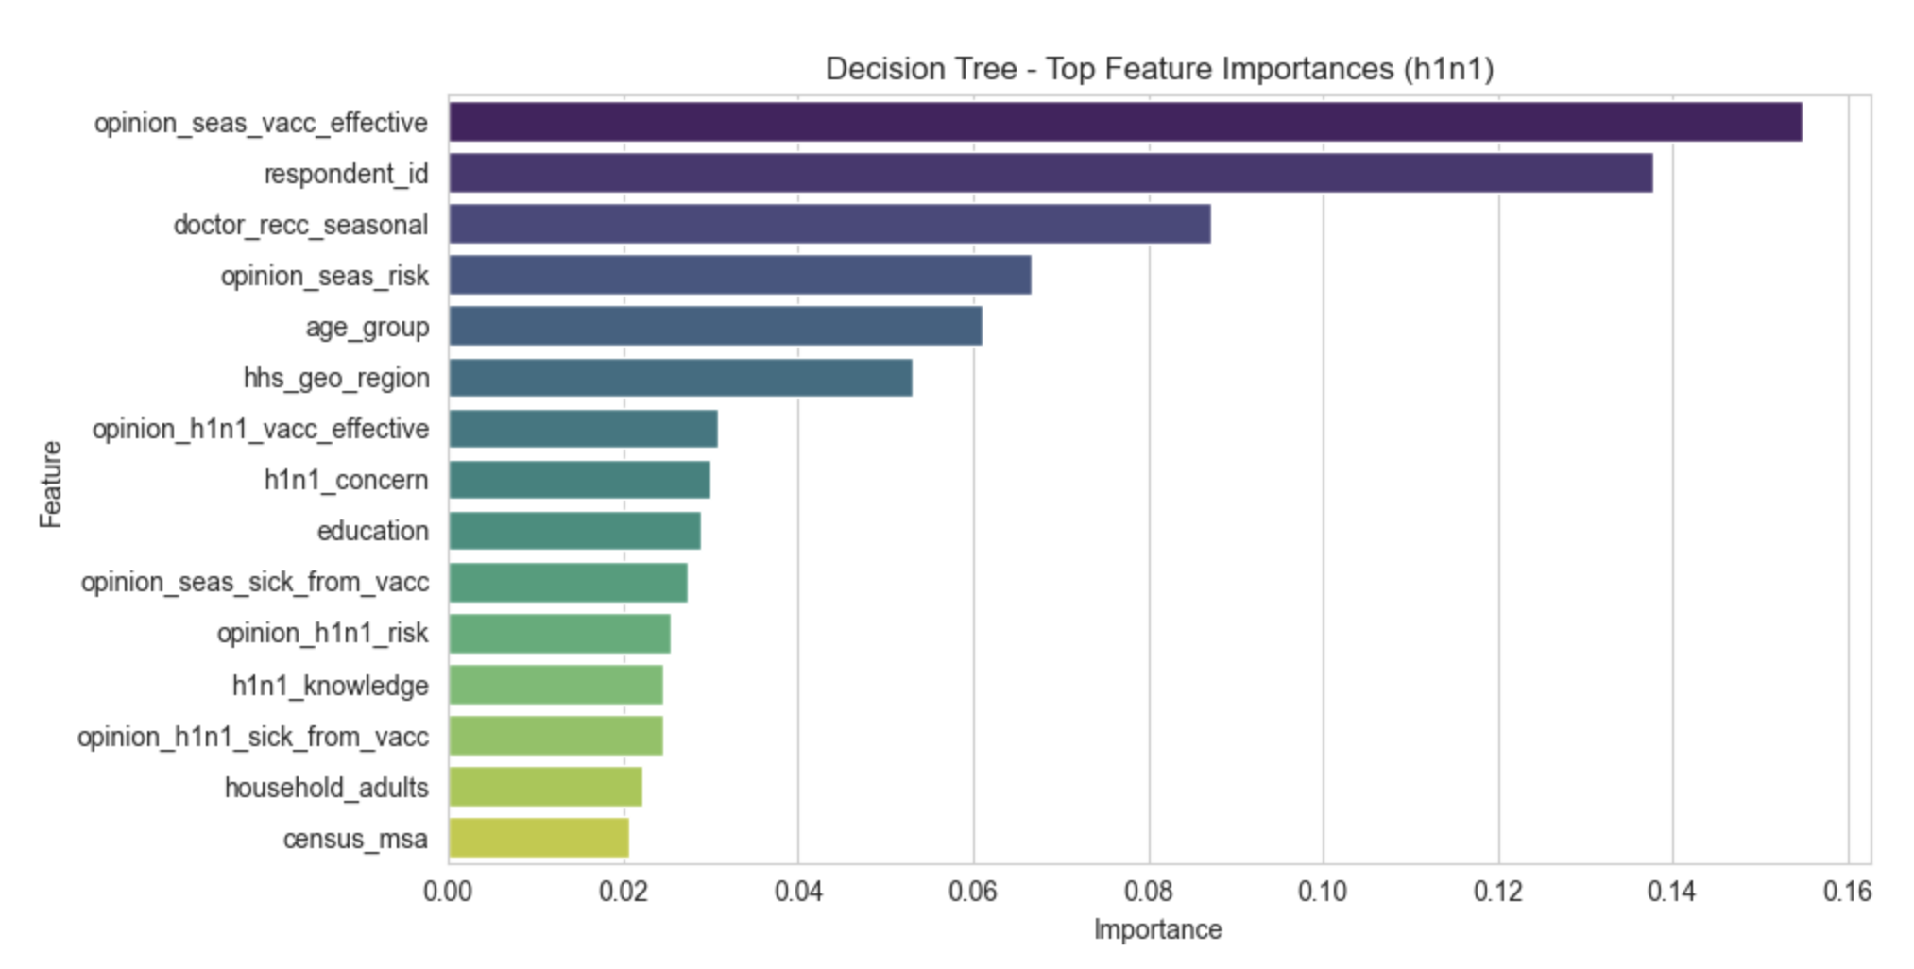
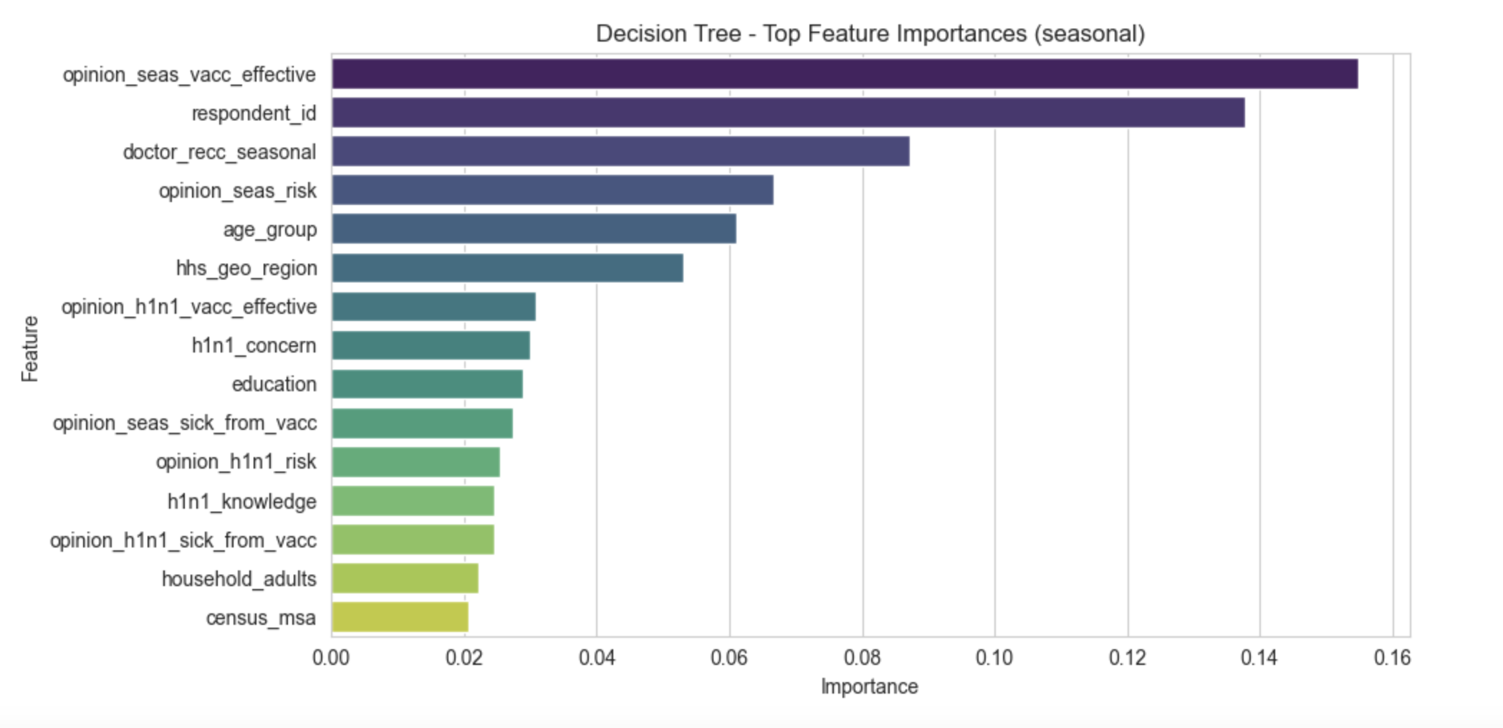
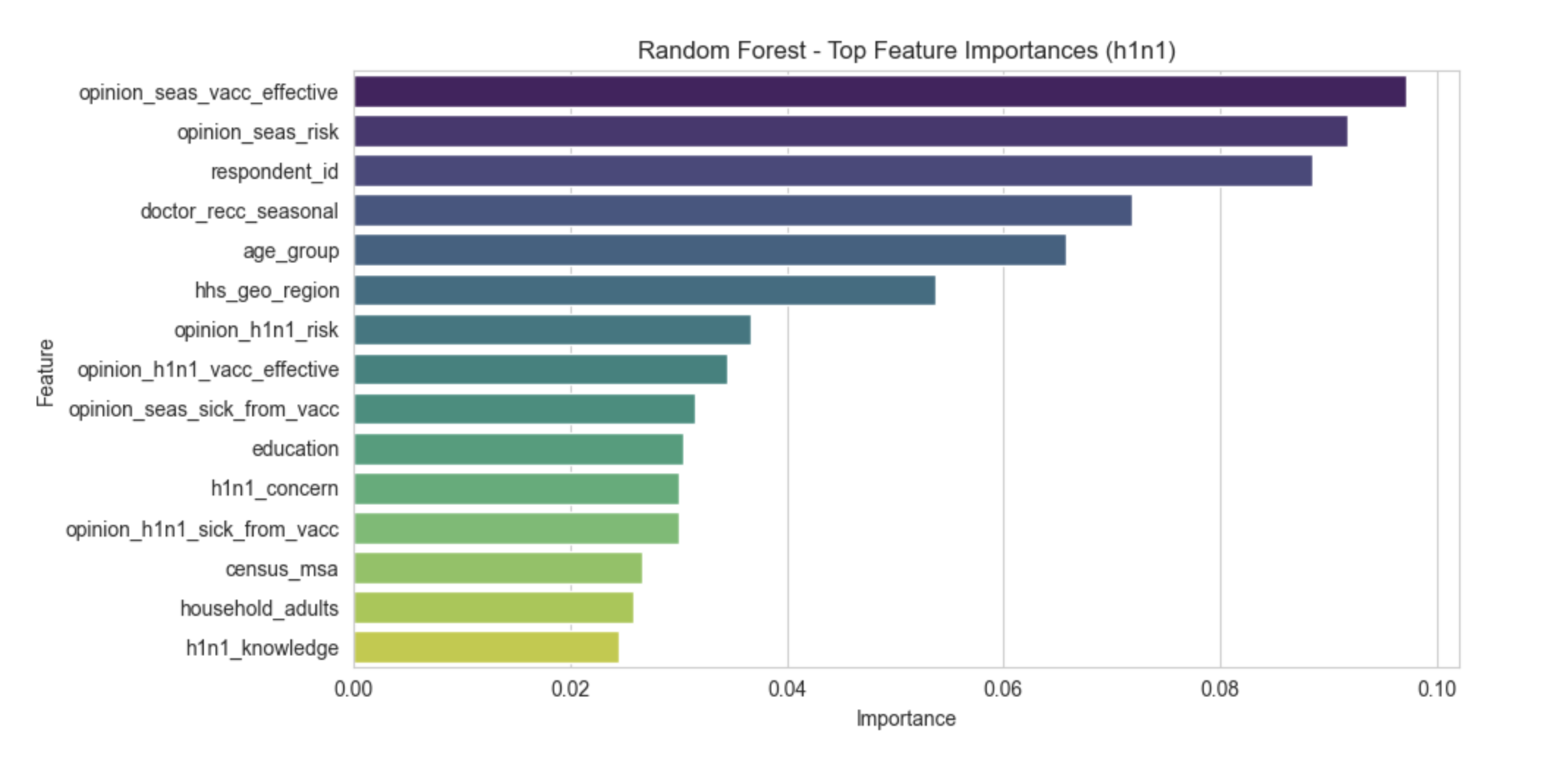
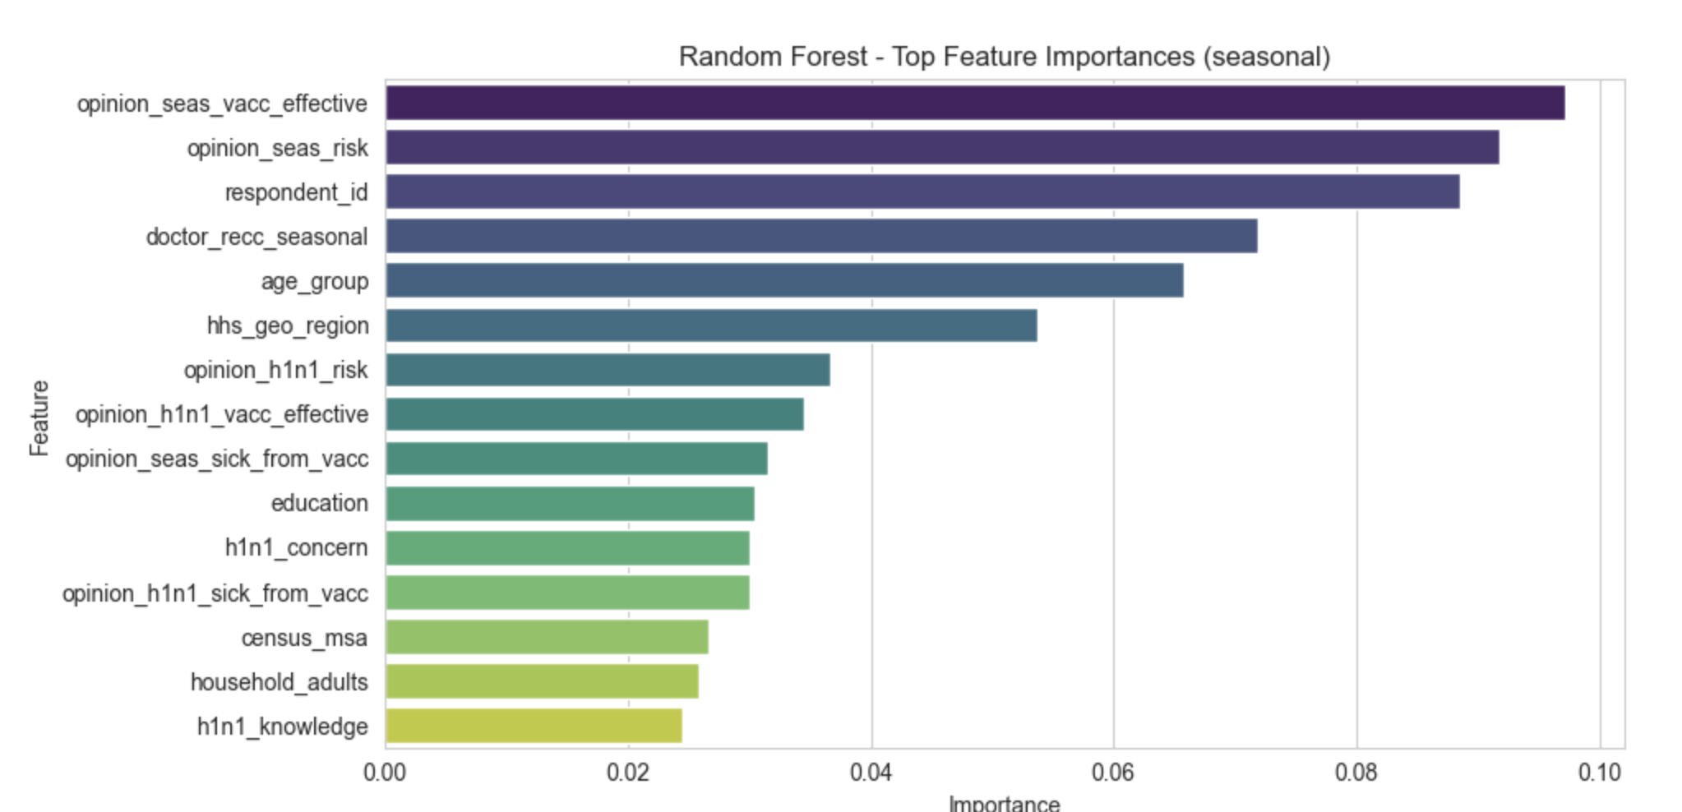
Feature Importance - H1N1 & Seasonal Vaccine

Slide 15
Key Features, Insights & Recommendations
Top Influencing Features
High impact features common across both SHAP and LR features models:
Vaccine confidence
Doctor recommendation
Risk perception
Insurance and access to care
Key Insights
Trust, access, and risk perception drive decisions
Information campaigns must address safety concerns
Doctor recommendation is a strong influence
Younger populations and uninsured less likely to vaccinate
Recommendations
Strengthen vaccine communication campaigns
Address vaccine hesitancy with data-driven messaging
Focus on groups:
Without health insurance
With low vaccine trust
Younger adults
Encourage doctors to promote vaccines during visits

Slide 16

Thank you!

